Slide 1
Full Stack Application Development
Understanding the Basic Web application
Structure of web applications
Frontend and Backend components
Akshaya Ganesan

Slide 2
Frontend Components
Backend Components

Slide 3
Components
Based on the N-tier architecture and where each tier is deployed ,we can group the components of the web application
Frontend components- Client Tier
Backend components- Server Tier, Data Tier,
Application/middleware tier

Slide 4
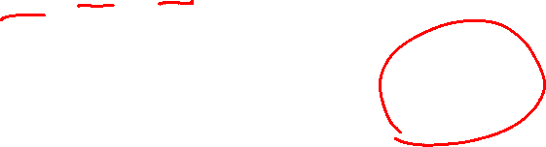
Traditional Web Application
Frontend
Backend
Web Server
Client(Browser)
Business Logic
HTML
CSS
JS
Static content
Client(Browser)
Presentation Logic
Client(Browser)
Client Tier
Internet
Server Tier
Data Tier

Slide 5

Modern Web Application
Frontend
Backend
Client(Browser)
Web Server
Business Logic
Static content
AJAX Request
JSON
Presentation Logic
Client Tier
Internet
Server Tier
Data Tier

Slide 6
Frontend and Backend
In the web, the client-server model
The client component (Frontend)
The web browsers that translate the code(HTML, CSS, JS) into an interface, such as dashboards, notifications, settings, and more.
These are a part of the web app interface layout. This is what the end user of the web app interacts with.
The server component (Backend)
It consists of the application logic and the database.
The application logic makes software perform the required tasks and respond to user requests while the database stores information.

Slide 7
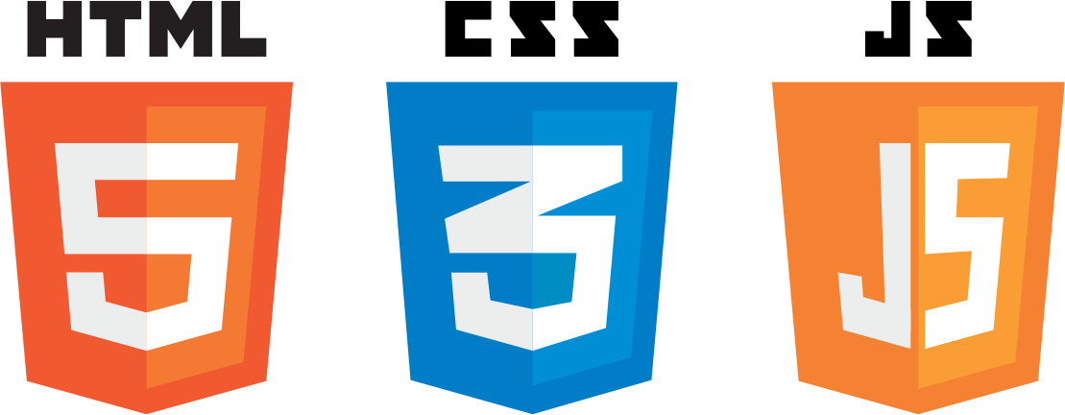
Frontend Elements
Involves elements for
Content Structure
Styling
Interaction
Deals with
Rendering of the content on the browsers / within apps
Styling of content rendered
Interaction carried out by user on web pages / mobile apps
Frontend is all about HTML + CSS + JS !!

Slide 8
Content Structure
The structure of the page is the foundation of websites.
HTML stands for HyperText Markup Language
HTML describes the structure of a web page using markup elements
HTML elements are the building blocks of HTML pages

Slide 9
Styling
CSS determines how all the HTML elements must appear on the frontend
CSS (Cascading Style Sheets) styles the elements in web pages.
CSS is also used to define the layout of the webpages.
CSS is a language for writing style sheets.
Style Sheet: A set of rules that specify the presentation of a document.

Slide 10
Interactivity
JavaScript
User Interaction on the page
Dynamic Behavior
User Interaction and interaction with backend

Slide 11
Front-end Responsibilities
User Interface elements
Mark-up and web languages such as HTML, CSS, JavaScript and supporting libraries
Asynchronous request handling and AJAX
Single-page applications (with frameworks like React, AngularJS or Vue.js)
Web performance
Responsive web design
Cross-browser compatibility issues and workarounds
End-to-end testing with a headless browser
Build automation to transform and bundle JavaScript files, reduce image size
Search engine optimization
Accessibility concerns

Slide 12
Backend Elements
Server (web / application server)
Database
API
Focus is on

Slide 13
Web Servers
On the software side, a web server includes several parts that control how web users access hosted files.
An HTTP server is software that understands URLs (web addresses) and HTTP (the protocol your browser uses to view webpages).
It can be accessed through the domain names of websites it stores and delivers their content to the end-user's device.

Slide 14
Managing Database
It is responsible for accepting that query, fetching the data, and returning it to the website
Searching for a product in an online store

Slide 15
API(Application Programming Interface)
An API(application programming interface) is a set of defined rules that enable different applications to communicate with each other.
It acts as an intermediary layer that processes data transfers between systems,
It allows companies to open their application data and functionality to external third-party developers.

Slide 16
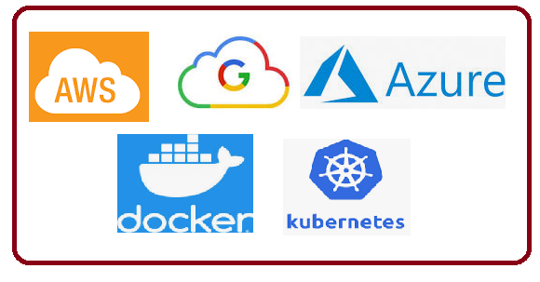
Server Side architecture
The “traditional” back end was simple.
Mix of the server, databases, APIs, and operating systems that power an app’s front end.
The back end of applications can look very different from application to application based upon
frameworks
cloud-based servers
containerization with a service like Docker
Backend-as-a-Service (BaaS) providers
APIs to replace more complex processing

Slide 17
Backend Responsibilities
Software Architecture
Application Business Logic
Application Data Access
Database management
Scripting languages like JavaScript, Node.js, PHP, Python, Ruby, Java etc.
Automated testing frameworks for the language being used
Scalability
High availability
Security concerns, authentication and authorization

Slide 18
Frontend components
Backend components

Slide 19
Thank You!

